Slide 1
Week 02 assignments
Lab 02 this week
HW 01 due Thursday, Jan 18
Read chapter 4 (will come back to chapter 3)
Q&A taking place on Piazza
Notes:
15 clickers recorded, but without associated student name

Slide 2
Homework grading method
Each graded solution evaluated on a 3-point scale
0 – no solution shown; “Left it blank.”
1 – minimal progress towards a correct answer shown
2 – substantial progress shown, but either stopped short of a correct answer or reached an incorrect answer
3 – a correct answer, modulo inconsequential issues
Homework score reported in Blackboard as the percentage Earned Points/Available Points

Slide 3
Using Blackboard for labs, assignments
Type HW 01 text answers into the Word file; insert images of answer diagrams; then upload PDF or Word to correct place within Blackboard
GTAs will score, typically within 1 week
Lab 02 download assignment Word file from Blackboard; upload with inserted answers prior to start of your lab session next week
GTA will open your file for discussion and scoring

Slide 4
Lecture 04 – Combinatorial circuits
2018.01.17
Oh what a tangled web we weave …
Sir Walter Scott

Slide 5
Truth tables
A way to define a Boolean function
Value in consistent table organization
List input variable columns in a useful order, then
Have rightmost column “alternate” at 2⁰ interval, next column left at 2¹ interval, and k^{th} column at 2^{k} interval
A | B | C | ABC (3-input AND)
0 | 0 | 0 | 0
0 | 0 | 1 | 0
0 | 1 | 0 | 0
0 | 1 | 1 | 0
1 | 0 | 0 | 0
1 | 0 | 1 | 0
1 | 1 | 0 | 0
1 | 1 | 1 | 1

Slide 6
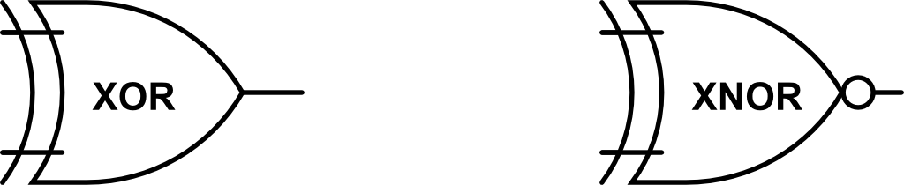
Tables for key 2-input functions
Text has tables for AND, OR, NOT, NAND, NOR
Here are XOR and XNOR
A | B | A⊕B
0 | 0 | 0
0 | 1 | 1
1 | 0 | 1
1 | 1 | 0
A | B | (A⊕B)’
0 | 0 | 1
0 | 1 | 0
1 | 0 | 0
1 | 1 | 1

Slide 7
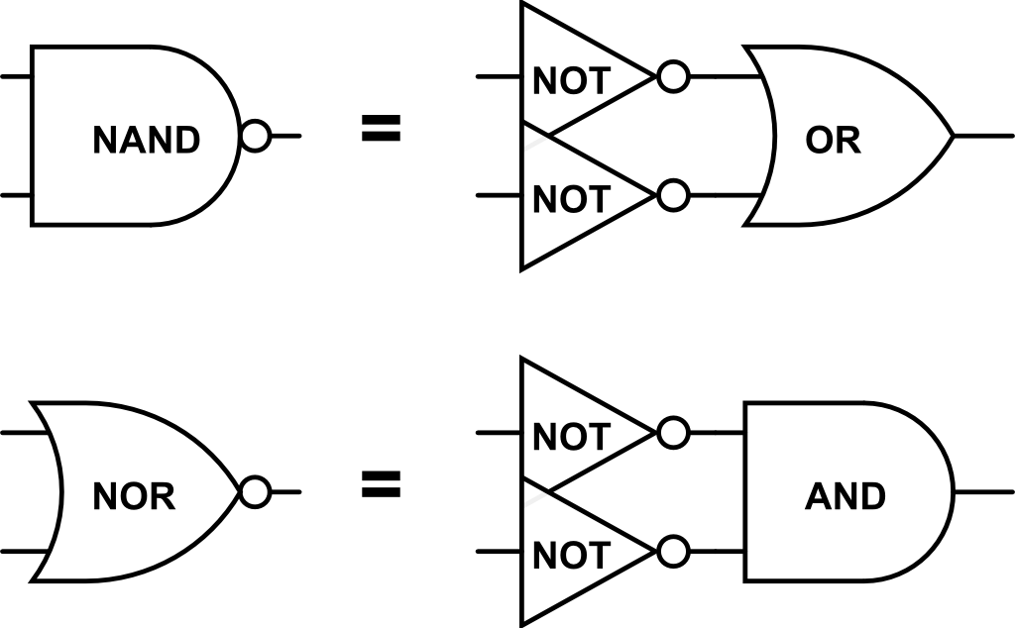
De Morgan’s Laws and gate equivalences
(AB)’ = A’ + B’
(A + B)’ = A’B’
A | B | (AB)’ | A’ | B’ | A’ + B’
0 | 0 | 1 | 1 | 1 | 1
0 | 1 | 1 | 1 | 0 | 1
1 | 0 | 1 | 0 | 1 | 1
1 | 1 | 0 | 0 | 0 | 0
A | B | (A + B)’ | A’ | B’ | A’B’
0 | 0 | 1 | 1 | 1 | 1
0 | 1 | 0 | 1 | 0 | 0
1 | 0 | 0 | 0 | 1 | 0
1 | 1 | 0 | 0 | 0 | 0

Slide 8
Seeing other functions in a truth table
Look at the truth table for NAND
Do other truth tables lie within?
Look for NOT in NAND
When other functions exist within a truth table it means a circuit can be used for more than one purpose
A | B | (AB)’
0 | 0 | 1
0 | 1 | 1
1 | 0 | 1
1 | 1 | 0
A | A’
0 | 1
1 | 0

Slide 9
Combinatorial circuit
Combinatorial logic – implements functions of logic inputs to generate a result or output (defined by its truth table)
Here, “combinatorial” means that the function, the computed result from the circuit, is defined by the combination of all the input values, and nothing else matters

Slide 10
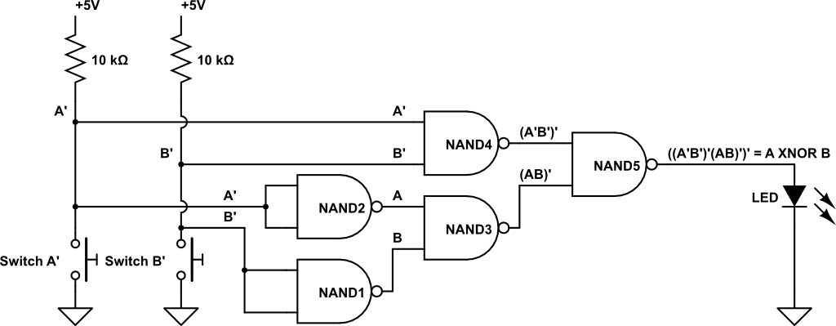
Lab 02 – A combinatorial logic circuit
Look for the “words” of the schematic, link those words into the “statement of meaning,” see the grammar of abstraction used in the diagram

Slide 11
Look for the “words” in the circuit
Lab instructions say – “build a circuit using multiple two-input NAND gates …”
LOGIC GATES

Slide 12
Circuit diagram “words” of input
Lab reads – “build a circuit using multiple two-input NAND gates to implement … the two-input …”
INPUT

Slide 13
Look for the computed result – output
Lab reads – “build a circuit using multiple two-input NAND gates to implement … the two-input … XNOR function.”
OUTPUT

Slide 14
See the grammar of the diagram
Flowing from left to right to enhance readability:
input → logic → output
Now see hardware as software
Data (inputs), algorithm (logic), computed data (output)

Slide 15
Find the NOT gate(s) in this circuit

Slide 16
Key characteristics of CMOS logic gate
Two voltage levels with a generous “gap” between the acceptable ranges of voltages
Gate output voltage level quality set by power supply/ground reference voltages, not input voltages, so error cannot accumulate
Gates respond to new inputs fast, typically in ~ 10⁻¹⁰ second for gates in a processor chip
CMOS transistors are small, billions fit on a chip
CMOS gates require very little power, so chip stays cool
Chips are cheap to make in large quantities: thus, popular HW is affordable

Slide 17
What to know summary
Grammar of the schematic
Logic gates AND, OR, NOT, NAND, NOR, XOR, XNOR
Truth tables within truth tables
Characteristics of digital logic gates

Slide 18
Truth tables to Boolean expressions
You can represent any Boolean function as
Sum of products (SOP): Example z=xy + xy’
or as
Product of sums (POS): Ex. z=(x+y)(x’+ y’)
POS has an OR term for each 0 in the function; ANDs these terms together for all 0s in function
SOP and POS are generalizations of Disjunctive Normal Form and Conjunctive Normal Form
they allow for simplification of the expression, which is interesting because the corresponding hardware will be cheaper and likely faster

Slide 19
Sum of Products form Boolean expression
Sum of Products (SOP) form has one ANDed term for each 1 output of the function; then ORing these terms together gives an expression with all of the 1s in the function
A | B | C
0 | 0 | 0 | 1
0 | 0 | 1 | 0
0 | 1 | 0 | 0
0 | 1 | 1 | 1
1 | 0 | 0 | 0
1 | 0 | 1 | 0
1 | 1 | 0 | 1
1 | 1 | 1 | 0
A’B’C’ + A’BC
+ ABC’
A’B’C’
A’BC
ABC’

Slide 20
Sum of Products (SOP) form
Create Sum of Products form (the OR of AND-terms) from a truth table
AND outputs 1 for a single input value combination, 0 else
If input X = 1 then use X in the AND term, if X = 0 use X’
OR together AND-terms gives Boolean expression that generates every 1 in the output, and every 0 as side effect
X | Y | Z
0 | 0 | 0
0 | 1 | 1
1 | 0 | 1
1 | 1 | 0
Z = X’Y + XY’
What circuit corresponds to this equation?

Slide 21
Product of Sums (POS) form
Create Product of Sums form (the AND of OR-terms) from a truth table
OR outputs 0 for a single input value combination, 1 else
If input X = 0 then use X in the OR term, if X = 1 use X’
AND together OR-terms gives Boolean expression that generates every 0 in the output, and every 1 as side effect
X | Y | Z
0 | 0 | 0
0 | 1 | 1
1 | 0 | 1
1 | 1 | 0
Z = (X + Y)(X’ + Y’)
What circuit corresponds to this equation?

Slide 22
Building any circuit using only NAND
Convert SOP to only NAND by inverting twice and simplifying
Example (Lab 02): z = x XOR y = xy'+x'y as SOP form
Negate SOP twice and apply De Morgan’s Law
z = ((xy'+x'y)')' = ((xy')'(x'y)')’ = (x NAND y') NAND (x' NAND y)
Also, since x'= (x x)' = x NAND x and y' = y NAND y then:
z = (x NAND (y NAND y)) NAND ((x NAND x) NAND y)
Compare this expression with the Lab 02 circuit

Slide 23
Boolean expression simplification
Simplification can reduce the number of gates needed to implement a logic expression
Example:
z = a’b’c + a’b’ + ac’ + abc’; 4 ANDs, 1 (big) OR
= a’b’(c+1) + ac’(1+b)
= a’b’+ ac’ ; 2 ANDs, 1 OR
Example:
m = x’yz + x’yz’ + x’y’ + xyz ; 4 ANDs, 1 big OR
= x’y(z+z’) + x’y’ + xyz
= x’y + x’y’ + xyz
= x’(y+y’) + xyz
= x’ + xyz ; 1 AND, 1 OR

Slide 24
Incompletely specified function; example
INPUTS____
OUTPUTS____
A | B | C | D | W | X | Y | Z
0 | 0 | 0 | 0 | 0 | 0 | 0 | 1
0 | 0 | 0 | 1 | 0 | 0 | 1 | 0
0 | 0 | 1 | 0 | 0 | 0 | 1 | 1
0 | 0 | 1 | 1 | 0 | 1 | 0 | 0
0 | 1 | 0 | 0 | 0 | 1 | 0 | 1
0 | 1 | 0 | 1 | 0 | 1 | 1 | 0
0 | 1 | 1 | 0 | 0 | 1 | 1 | 1
0 | 1 | 1 | 1 | 1 | 0 | 0 | 0
1 | 0 | 0 | 0 | 1 | 0 | 0 | 1
1 | 0 | 0 | 1 | 0 | 0 | 0 | 0
1 | 0 | 1 | 0 | X | X | X | X
1 | 0 | 1 | 1 | X | X | X | X
1 | 1 | 0 | 0 | X | X | X | X
1 | 1 | 0 | 1 | X | X | X | X
1 | 1 | 1 | 0 | X | X | X | X
1 | 1 | 1 | 1 | X | X | X | X
Table input is all combinations of 4 binary digits (gold columns)
Function is to increment a decimal digit value modulo 10
Binary inputs combinations 1010 through 1111 do not represent a decimal digit, so we Don’t Care how the circuit behaves for these cases, denote with X
If we don’t care how it behaves, then We Can Choose any way we want for how it behaves
Usually choose simple and cheap e.g., replace X in Z by Z = D’

Slide 25
Example with don’t cares chosen, making the specification complete
INPUTS____
OUTPUTS____
A | B | C | D | W | X | Y | Z
0 | 0 | 0 | 0 | 0 | 0 | 0 | 1
0 | 0 | 0 | 1 | 0 | 0 | 1 | 0
0 | 0 | 1 | 0 | 0 | 0 | 1 | 1
0 | 0 | 1 | 1 | 0 | 1 | 0 | 0
0 | 1 | 0 | 0 | 0 | 1 | 0 | 1
0 | 1 | 0 | 1 | 0 | 1 | 1 | 0
0 | 1 | 1 | 0 | 0 | 1 | 1 | 1
0 | 1 | 1 | 1 | 1 | 0 | 0 | 0
1 | 0 | 0 | 0 | 1 | 0 | 0 | 1
1 | 0 | 0 | 1 | 0 | 0 | 0 | 0
1 | 0 | 1 | 0 | 1 | 0 | 0 | 1
1 | 0 | 1 | 1 | 0 | 1 | 0 | 0
1 | 1 | 0 | 0 | 1 | 1 | 0 | 1
1 | 1 | 0 | 1 | 0 | 1 | 0 | 0
1 | 1 | 1 | 0 | 1 | 1 | 0 | 1
1 | 1 | 1 | 1 | 1 | 0 | 0 | 0
Trying for simple and cheap
e.g., replace X in Z by Z = D’ because most of Z already is Z = D’ so this choice means the circuit to compute Z for all inputs is a NOT gate with input D
Choices for completely specifying W, X, and Y shown that yield cheap circuits; other cheap choices are available

Slide 26
Karnaugh map
Visual technique for simplification of Boolean expressions
Karnaugh map depicts truth tables using algebraic adjacency
Adjacent columns or rows in the map differ by only by one variable
Makes refactoring obvious visually

Slide 27
Example
Given Sum of Products (SOP) expression R = X’Y’Z+X’YZ’+X’YZ+XYZ’
Create this truth table
Now, create a Karnaugh map and fill the map with the function, R, values
X | Y | Z | R
0 | 0 | 0 | 0
0 | 0 | 1 | 1
0 | 1 | 0 | 1
0 | 1 | 1 | 1
1 | 0 | 0 | 0
1 | 0 | 1 | 0
1 | 1 | 0 | 1
1 | 1 | 1 | 0

Slide 28
Karnaugh map for R(X,Y,Z)
X | Y | Z | R
0 | 0 | 0 | 0
0 | 0 | 1 | 1
0 | 1 | 0 | 1
0 | 1 | 1 | 1
1 | 0 | 0 | 0
1 | 0 | 1 | 0
1 | 1 | 0 | 1
1 | 1 | 1 | 0
XY Z | 00 | 01 | 11 | 10
0 | 0 | 1 | 1 | 0
1 | 1 | 1 | 0 | 0

Slide 29
Karnaugh map for R
X | Y | Z | R
0 | 0 | 0 | 0
0 | 0 | 1 | 1
0 | 1 | 0 | 1
0 | 1 | 1 | 1
1 | 0 | 0 | 0
1 | 0 | 1 | 0
1 | 1 | 0 | 1
1 | 1 | 1 | 0
1
1
XY Z | 00 | 01 | 11 | 10
0 | 0 | 1 | 1 | 0
1 | 1 | 1 | 0 | 0
0
Any 2 left-right or up-down adjacent 1s define 1 input that is both 0 and1, so can omit from the sum of products term
X=0 and X=1 so oval is just YZ’
Y=0 and Y=1 so oval is just X’Z
Z=0 and Z=1 so oval is just X’Y

Slide 30
Karnaugh map adjacency
Any two cells that differ by only 1 input variable are adjacent
Here are some adjacent cell pairs
Note that the left-right and top-bottom edges of this K-map are adjacent
XY Z | 00 | 01 | 11 | 10
0
1

Slide 31
K-map and bigger groupings
Any adjacent group of size 2^{j} is a valid simplification
For this map what groups are possible?
XZ’
XZ
Y’Z’
Y’Z
X
Y’
XY Z | 00 | 01 | 11 | 10
0 | 1 | 0 | 1 | 1
1 | 1 | 0 | 1 | 1
So this truth table, in the form of a K-map, can be written in simplified SOP form (cover all the 1s) as X + Y’

Slide 32
Karnaugh map and Don’t Care
K-map cells fill with X just fine, too
Find biggest cover groups using each X as best helps
This cover does not use X and yields YZ + XY + XZ’
This cover uses X, gives X + YZ a simpler expression and a simpler circuit
XY Z | 00 | 01 | 11 | 10
0 | 0 | 0 | 1 | 1
1 | 0 | 1 | 1 | X

Slide 33
Value from unused gates
Use “left over” gates on a chip to do other operations instead of adding a new chip
Example:
X NAND 1 = X’ ; no need to use an inverter chip when there is a spare NAND gate in a chip

